Slide 1
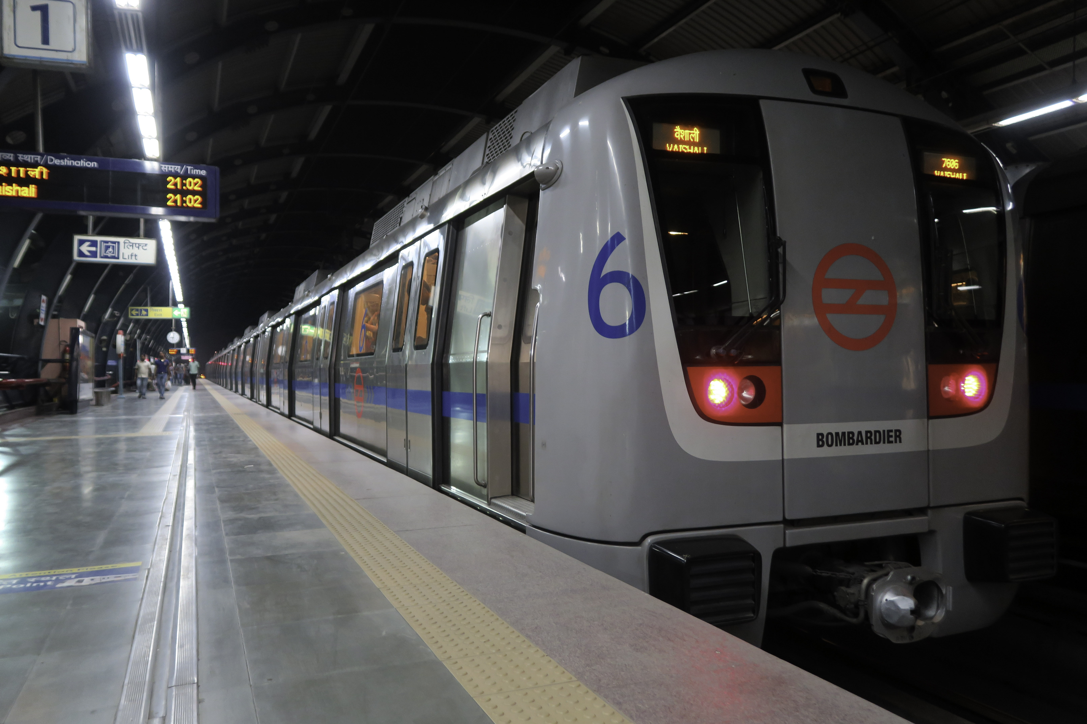
INSTITUTE OF SCIENCE, NAGPUR
A Study on Punctuality,
Commuter Perception &
Urban Mobility
[ Photo ]
Focus: Nagpur Metro Rail
Farhin Baig
B.Sc. Statistics – Semester IV | Guide: Dr. Preeti Singh | 2025–26
Department of Statistics | Institute of Science, Nagpur

Slide 2
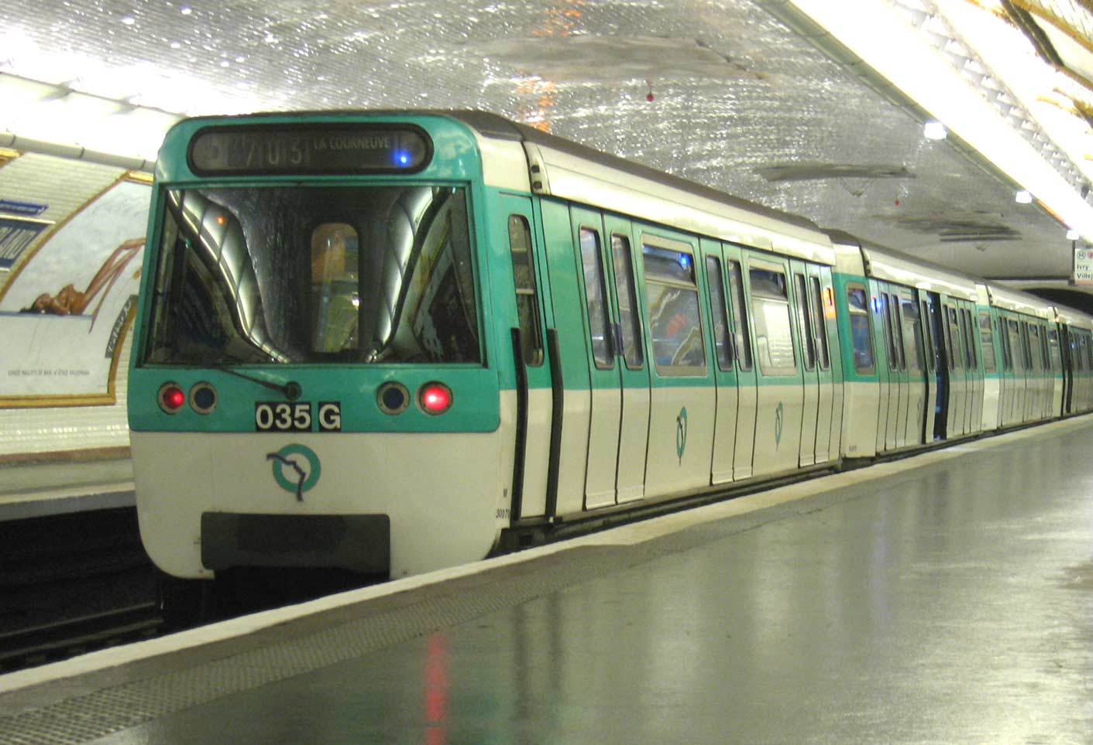
PRESENTATION OVERVIEW
Introduction to Metro Systems
01
London, Kolkata, Delhi & Nagpur Metro — origin and significance
Research Methodology
02
Survey design, data collection, 82 responses from Nagpur commuters
Literature Review
03
Benchmarks — Delhi (95%), Bangalore (92%), Tokyo (98%) vs Nagpur (90%)
Data Analysis & Key Findings
04
9 survey questions — frequency tables, charts, and statistical output
Conclusions & Recommendations
05
What the data says and what MahaMetro should do next

Slide 3
CHAPTER 1 — Introduction to Metro Systems
What Is a Metro Rail System?
A metro is a city-level train network built to carry large numbers of passengers quickly — running on dedicated tracks, completely separate from road traffic. It reduces congestion, cuts pollution, and makes cities far more connected.
⚡
🛤️
🔗
🏙️
Electrically Powered
Dedicated Tracks
Integrated Transport
Urban Growth Engine
Clean energy, reduced carbon emissions
No interference from road traffic
Connected with buses, trams & rail
Drives economic & social development
Today, over 200 cities worldwide operate metro systems — continuing a tradition that started in London over 160 years ago.
Metro systems are the backbone of sustainable smart city infrastructure.

Slide 4
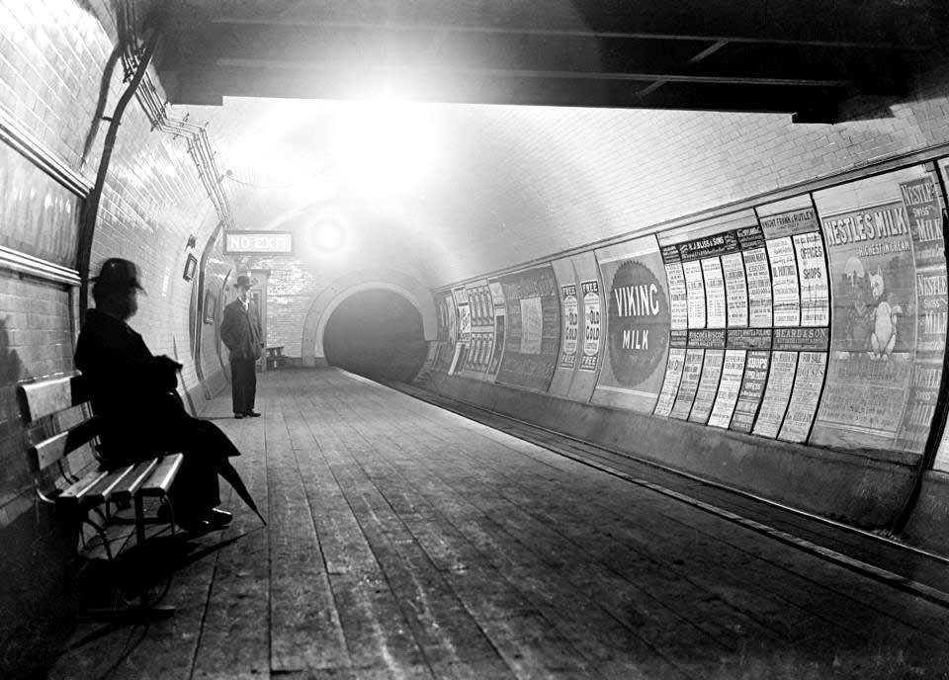
London Underground — Where It All Began
The World's First Metro
The London Underground — "The Tube" — opened in 1863, making it the world's first metro system. It connected Paddington to farringdon street. Trains were stream locomotives running underground tunnels.the first deep level electric tube line in the world.
[ Insert London
Underground Photo ]
1863
272
Year Opened
Stations
402 km
~4M
Track Length
Daily Passengers
Every metro system built today carries forward what London started in 1863.

Slide 5
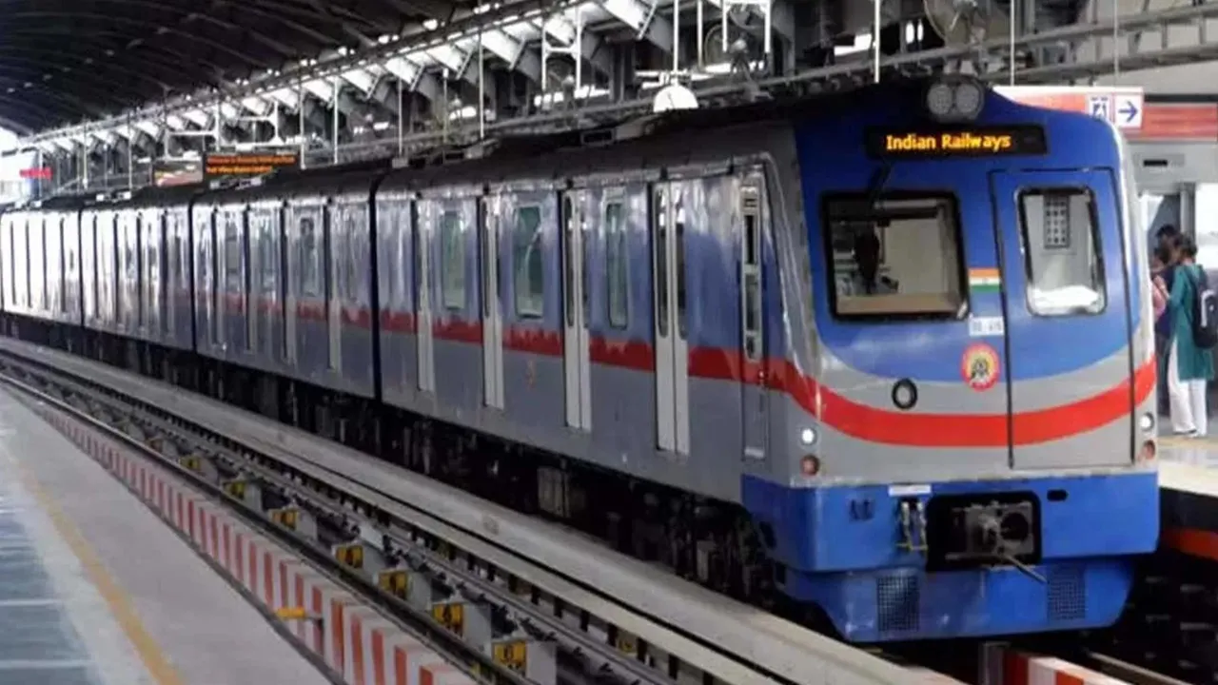
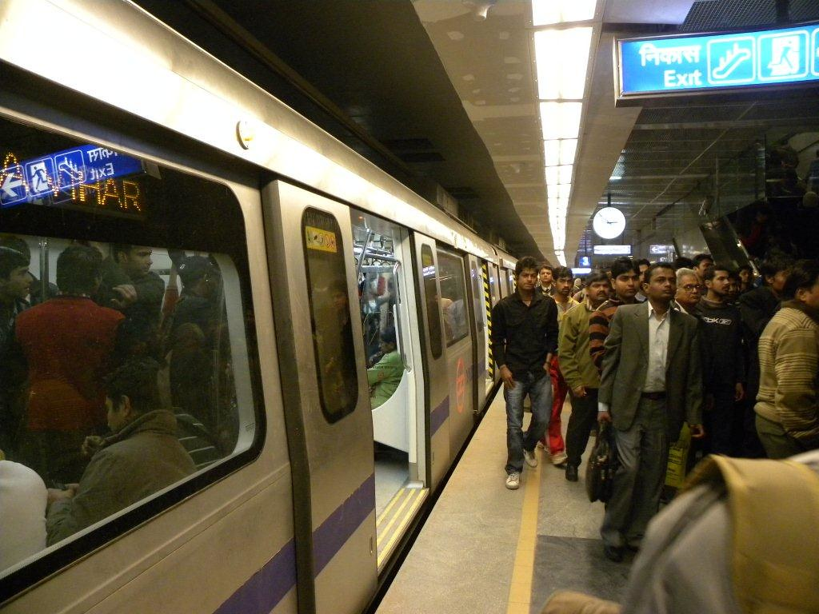
Metro in India — Kolkata (1984) & Delhi (2002)
KOLKATA METRO — 1984
DELHI METRO — 2002
[ Kolkata Metro Photo ]
[ Delhi Metro Photo ]
India's very first metro — inaugurated in 1984. It was a breakthrough: proof that Indian cities could build world-class underground rail. At the time, it was only the second metro in Asia outside Japan.
Delhi Metro transformed urban commuting in India. Efficient, safe, and reliable — it became the gold standard for every metro project launched after it. It operates at 95% punctuality, reducing 400,000+ car trips per day.
27 Stations | 32 km | Oldest Metro in India
286 Stations | 391 km | 3rd Largest in World
India today has 1,000+ km of metro across 23 cities — 3rd largest network in the world.

Slide 6
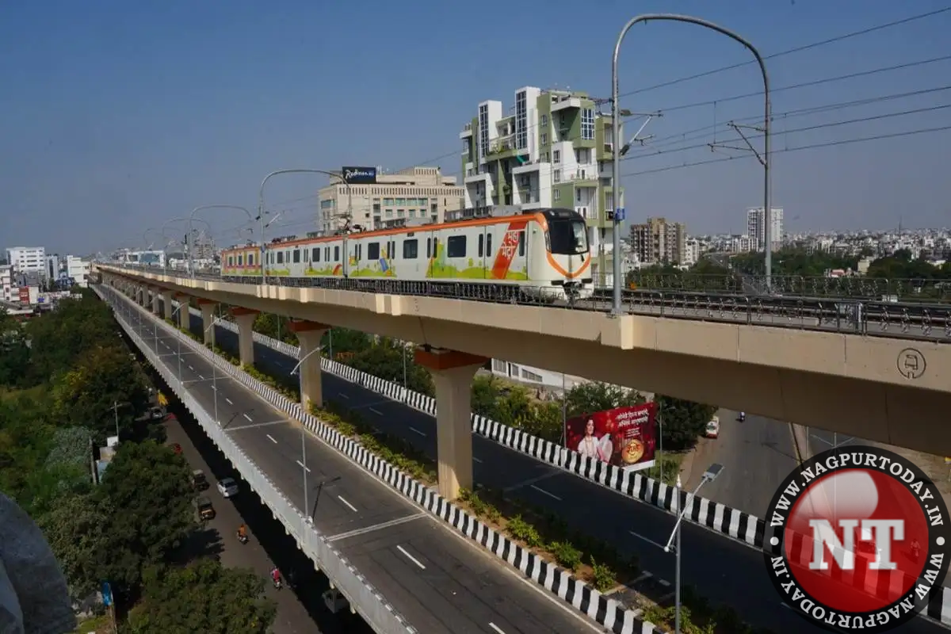
Nagpur Metro — India's First Green Metro (2019)
Operated by MahaMetro — Maharashtra Metro Rail Corporation Limited.
Inaugurated: 8 March 2019
🟠 Orange Line + 🔵 Aqua Line
2 Corridors, 38 km, 37 Stations
[ Nagpur Metro Photo ]
🌿 India's First Green Metro
Solar power + eco-friendly construction
⚡ 25 kV AC Electrification
Standard gauge, advanced signaling
🚀 Phase 3 Expansion
129 km planned — CMP 2025
Nagpur is one of India's first Tier-2 cities to have its own metro — making it a landmark case study in accessible urban mobility.
Current punctuality: ~90% | Benchmark: Delhi 95%, Tokyo 98%

Slide 7
CHAPTER 2 — Research Methodology
1. Research Design
2. Data Collection
Mixed approach — primary survey data + secondary published reports. Primarily quantitative in nature.
Structured questionnaire shared via Google Forms (online) and in-person at Nagpur Metro stations (offline). Both modes ensure broad reach.
3. Sampling
4. Statistical Tools Used
Convenience sampling — WhatsApp groups, social media & station intercepts. Only active Nagpur Metro users were included.
Mean, Variance, Standard Deviation, Percentage Analysis, Weighted Average, Frequency Distribution Tables, Chi-Square Test.
82 valid responses collected | Online + Offline modes | 2025–26

Slide 8
Survey Design & Questionnaire Overview
📄 Mode
Google Forms (Online)
+ In-Person at Station
👤 Sample
82
Valid Responses
🎯 Sampling
Convenience Sampling
WhatsApp + Social Media
📅 Year
2025–26
Survey Questions (9 Total)
Purpose of traveling by metro
Age group of respondent
Gender of respondent
Frequency of metro usage
Peak travel time slot
Average delay faced by commuters
Rating of metro punctuality (1–5)
Staff helpfulness rating
Overall satisfaction with Nagpur Metro
n = 82 valid responses | Mixed method: Online (Google Forms) + Offline (Station intercept) | 2025–26

Slide 9

Data analysis

Slide 10
CHAPTER 4 — Data Analysis: Statistical Tools Applied
📊 Frequency Distribution
All 9 questions tabulated
with % and f values
📈 Mean, Variance & SD
Punctuality: Mean 3.83
Variance 1.12, SD 1.06
⚖ Weighted Average
Satisfaction score
computed as 4.09/5
Weighted Average Calculation — Overall Satisfaction (Q9)
Category (x) Weight (w) Freq (f) w×f
Very Satisfied 5 25 125
Satisfied 4 43 172
Neutral 3 11 33
Dissatisfied 2 1 2
Very Dissatisfied 1 1 1
Total (N = 82) 82 333
Weighted Average = Σ(w×f) / N = 333 / 82 = 4.06 / 5 → High overall satisfaction

Slide 11
INTERPRETATION:
CHAPTER 3 — Literature Review & Global Benchmarks ( Here i have taken references from previous study for comparison)
This graph shows a comparision of metro across four cities.
NAGPUR metro rail cor[oration recorded about 90% punctuality.
Delhi metro performs better with 95% person.
Bengaluru with slightly higher 92%
The highest punctuality s observed in Tokyo.
—
Every study confirms: passengers value punctuality above all else.

Slide 12
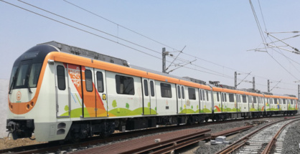
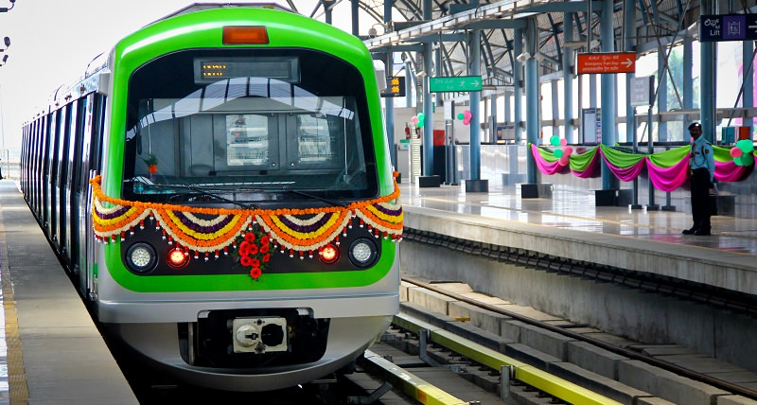
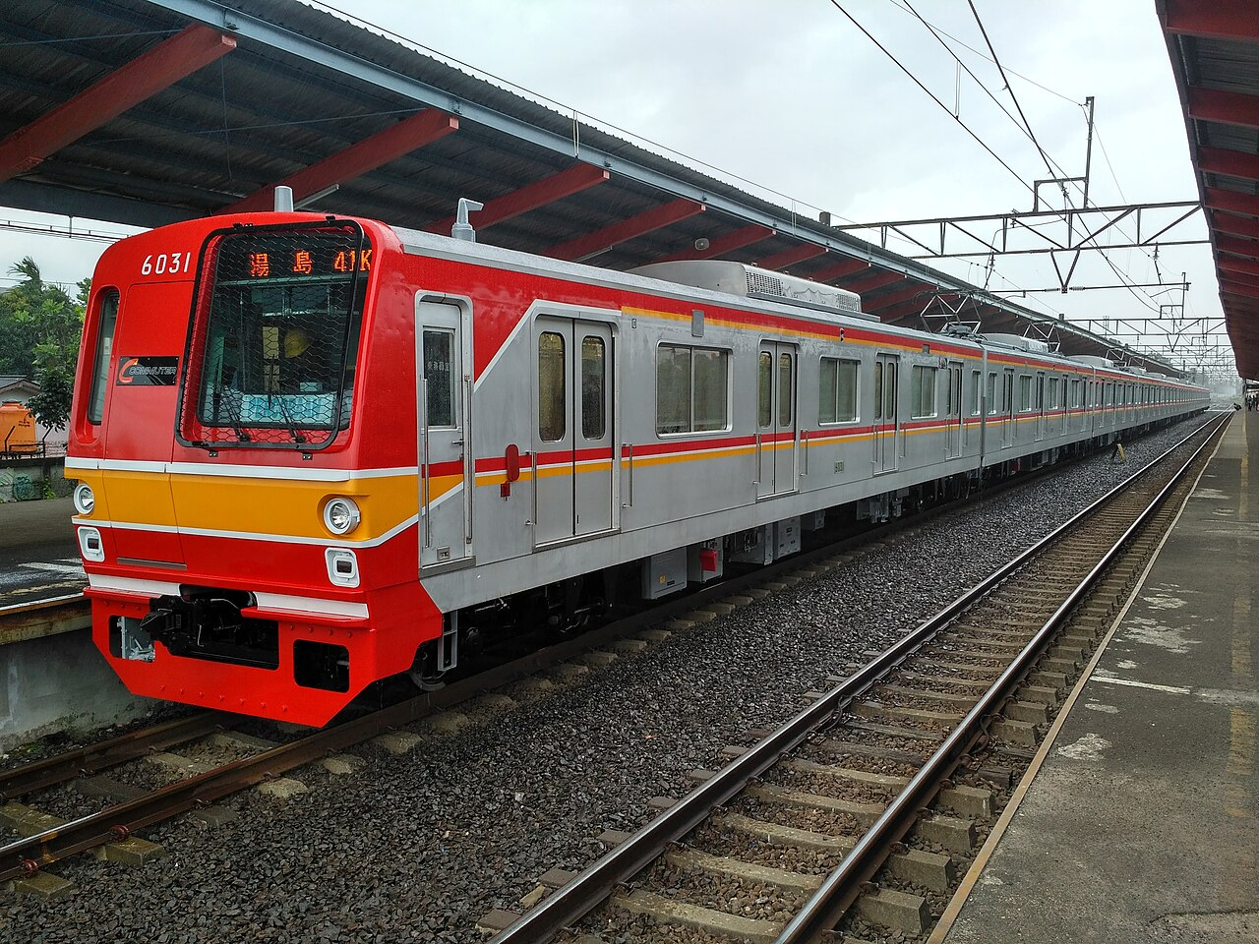
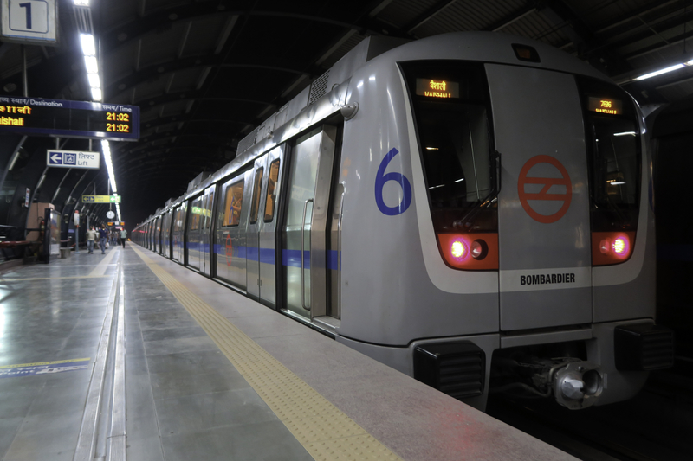

Slide 13
Q1. What is your main purpose of traveling by metro?
76.8%
travel for EDUCATION
Interpretation
63 out of 82 respondents use Nagpur Metro for educational travel. The metro route passes near several colleges and coaching institutes, making it the preferred choice for students. Any disruption during morning or afternoon slots directly affects academic schedules.
n = 82 | Education dominates at 76.8% — Nagpur Metro is a student-first system.

Slide 14
Q2 & Q3. Age Group & Gender of Respondents
Age Distribution (n=82)
Gender Split
86.6%
71 respondents
FEMALE
13.4%
11 respondents
MALE
Women prefer metro for its safety, cleanliness, and affordability — especially students and working women in Nagpur. 92.7% of all commuters are under 30 years old. It confirms that metro is youth driven system.
70.7% are aged 15–20 | 86.6% are female | Metro appeals strongly to young women.

Slide 15
Q4 & Q5. Travel Frequency & Peak Travel Time
How Often Do Commuters Travel?
When Do They Travel?
52.5% travel at least 2–3x/week | Afternoon (51.2%) is the most critical operational slot.

Slide 16
Q6. How much delay do commuters face on average?
73.2%
face SOME delay
46.3%
minor 1–5 min delay
26.8%
delay of 6+ minutes
6+ minute delays disrupt academic and work schedules — primarily affects student commuters.

Slide 17
Q7. Rate Metro Punctuality (Scale: 1 to 5)
3.83
Mean Score
out of 5
1.12
Variance
(σ²)
1.06
Std. Dev.
(σ)
67.1%
Rated
Good/Excellent
67.1% rated Good or Excellent | Mean: 3.83/5 | Most commuters tolerate minor delays and still rate positively.

Slide 18
Q8 & Q9. Staff Behaviour & Overall Satisfaction
Staff Helpfulness Rating
Overall Satisfaction
85.4% rated staff Good/Excellent | Weighted satisfaction: 4.09/5 | 82.9% are Satisfied or Very Satisfied.

Slide 19
Chi-Square Test — Gender vs. Purpose of Travel
H₀ (Null Hypothesis): There is no significant association between gender and purpose of metro travel.
H₁ (Alt Hypothesis): There is a significant association between gender and purpose of metro travel.
Observed Frequency Table (O)
Chi-Square Formula
χ² = Σ (O − E)² / E
E = (Row Total × Col Total) / N
df = (r−1)(c−1) = (3−1)(2−1) = 2
Critical value (α=0.05, df=2) = 5.991
Purpose Female Male Total
Education 56 7 63
Work/Office 5 2 7
Leisure/Other 10 2 12
Total 71 11 82
Calculated χ² ≈ 1.24 | df = 2 | Critical Value = 5.991 (α = 0.05)
Conclusion: Since χ² (1.24) < Critical Value (5.991), we fail to reject H₀.
Gender and travel purpose are NOT significantly associated — both male and female commuters predominantly travel for education.

Slide 20
Overall Summary of Findings
76.8%
travel for Education
70.7%
aged 15–20 years
Students are the dominant ridership
Metro is primarily a youth service
86.6%
female commuters
73.2%
face some delay
Safety & affordability attract women
Mostly minor 1–5 min delays (46.3%)
3.83/5
punctuality rating
4.09/5
satisfaction score
Variance 1.12 | Std Dev 1.06
82.9% satisfied or very satisfied
85.4%
rated staff Good/Excellent
90%
punctuality (vs Delhi 95%)
Human service quality is a key strength
5–8% gap to close vs benchmarks
Strong start for a Tier-2 city — but addressing delays in peak hours is the next priority.

Slide 21
CHAPTER 6 — Conclusions
Nagpur Metro is working well for students
1
People use it because it's affordable, safe, and clean. These three things came up consistently across all 82 responses.
73.2% face delays — but still rate it 4.09/5
2
This is a well-known pattern called 'tolerance absorption' in transport research. Minor delays are accepted as long as the overall service feels reliable.
Afternoon slot (10AM–4PM) is critical
3
51.2% of all travel happens in this window. Any delay during this time hits the maximum number of commuters, mostly students heading home from college.
Staff behaviour is a real strength
4
85.4% rated staff Good or Excellent. Good staff interaction reduces frustration when delays occur — and Nagpur Metro is doing this right.
90% punctuality is good but not enough
5
Tokyo runs at 98%, Delhi at 95%. Nagpur has a 5–8% gap to close. This is a strategic priority for MahaMetro going forward.
Nagpur Metro has changed urban mobility in a Tier-2 city — and the data backs it up.

Slide 22
CHAPTER 7 — Recommendations
Operations
Technology
Ridership
Increase train frequency during 10AM–4PM (51.2% of travel is here)
Launch live train tracking on MahaMetro app + station display boards
Corporate tie-ups & monthly pass incentives to attract working professionals
Reduce headways to 5–7 min during morning & afternoon peak
Real-time delay notifications — reduces frustration even when delays happen
Feeder buses + e-rickshaw integration to fix last-mile connectivity
Adopt AI-based predictive maintenance (benchmark: Delhi Metro)
Use dashboards (Python/Excel) for ridership & delay pattern monitoring
Better ramps, lifts & assistance for senior citizens & differently-abled commuters
Survey commuters every 6 months to track whether improvements are working.

Slide 23
Chapter 8 — Limitations & Scope for Further Research
What This Study Couldn't Cover
Where To Take This Research Next
1. 82 responses is reasonable for a student study, but small against thousands of daily passengers
Longitudinal Study
Track same commuters over 2–3 years to measure improvement with Phase 3 expansion
2. All data is self-reported — not based on MahaMetro's operational records
Multi-City Comparison
3. 88% of respondents are below 30 — we missed senior citizens & differently-abled commuters
Compare Nagpur with Pune, Lucknow & Bhopal — identify best practices across Tier-2 metros
4. Only covers 2025–26; no seasonal variation or Phase 3 construction disruption captured
Regression Analysis
Find which factor drives satisfaction most — punctuality, staff, cleanliness, or fare?
5. No access to internal GPS or delay logs from MahaMetro
ML Delay Prediction
Machine learning models to predict delays using historical data, weather & event triggers
This study is a starting point — not the final word on Nagpur Metro.

Slide 24
Thank You
A Study on Punctuality, Commuter Perception & Urban Mobility
Focus: Nagpur Metro Rail
Farhin Baig
B.Sc. Statistics — Semester IV | Guide: Dr. Preeti Singh
Department of Statistics | Institute of Science, Nagpur | 2025–26

